Slide 1
Hands-on IoT
Dr. Tarkeshwar Barua

Slide 2
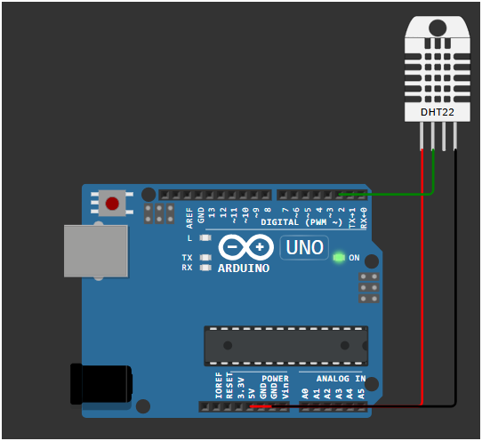
DHT with Arduino with Serial Read

Slide 3
DHT with Arduino with Serial Read
#include <DHT.h>
#define DHTPIN 2 // The DHT sensor is connected to Digital Pin 2
#define DHTTYPE DHT11 // The sensor is a DHT11
// Initialize the DHT sensor
DHT dht(DHTPIN, DHTTYPE);
void setup() {
Serial.begin(9600);
Serial.println("timestamp,temperature_celsius,humidity_percent"); // Print the CSV header
dht.begin();
delay(1000); // Wait for the sensor to stabilize
}
void loop() {
delay(5000);
// Read temperature and humidity

Slide 4
DHT with Arduino with Serial Read
float h = dht.readHumidity();
float t = dht.readTemperature();
// Check if any reads failed and exit early
if (isnan(h) || isnan(t)) {
Serial.println("Failed to read from DHT sensor!");
return;
}
// Get the current timestamp (in milliseconds since Arduino started)
unsigned long timestamp = millis();
// Print the data in CSV format
Serial.print(timestamp);
Serial.print(",");
Serial.print(t);
Serial.print(",");
Serial.println(h);
}

